Slide 1


ABOUT US
CAPSTONE PROJECT PRESENTATION
|
卒業論文プレゼンテーション
IVOLUNTEER
VOLUNTEER SOCIAL NETWORK
1

Slide 2





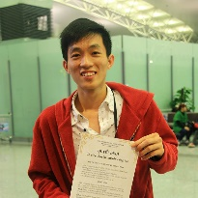

IVOLUNTEER
-
ABOUT US
TABLE OF CONTENT
PRESENTATION OUTLINE
Bùi Đình Chiến
Nguyễn Minh Đức
Instructor
Project Manager, Developer
Nguyễn Thạc Sơn
Võ Tôn Phúc
Technical Leader, Developer
Design Leader, Developer, Designer
Nguyễn Văn Tâm
Phạm Văn Trọng
Developer, Designer
Test Leader, QA, Tester
2

Slide 3
PRESENTATION OUTLINE
I . INTRODUCTION
I
Introduction
Project Management
II
導入
プロジェクト管理
III
Software Requirements Specification
Software Design Description
IV
ソフトウェア要求仕様
ソフトウェア設計説明書
V
Quality Control
Project Result
VI
品質管理
プロジェクト結果
VII
Demo
Q & A
VIII
デモ
質問と回答
3

Slide 4
PRESENTATION OUTLINE
I . INTRODUCTION
I
Introduction
Project Management
II
導入
プロジェクト管理
III
Software Requirements Specification
Software Design Description
IV
ソフトウェア要求仕様
ソフトウェア設計説明書
V
Quality Control
Project Result
VI
品質管理
プロジェクト結果
VII
Demo
Q & A
VIII
デモ
質問と回答
Coming
Võ Tôn Phúc
4

Slide 5
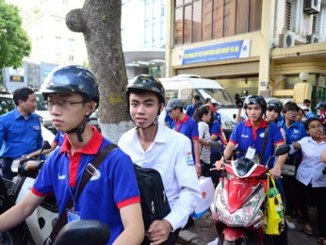

I . INTRODUCTION
1. Current Situation - 現在状況
2. The Idea - アイデア
I. 導入
5

Slide 6
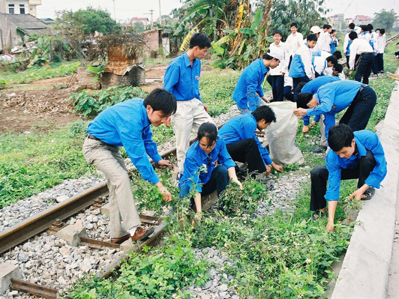

I . INTRODUCTION
1. Current Situation - 現在状況
2. The Idea - アイデア
Nowadays, Volunteering has been expanding in many countries in the world even in Vietnam
But the recent volunteering has revealed some limitations:
The communication of the events, coordinating the activities
Publicize and expand/ extent the platforms
Mentioning/ commending individuals who have contributed/ devoted for volunteering
2. The Idea - アイデア
3. Proposal - 提案
4. Benefit From Project - プロジェクト便益
I. 導入
6

Slide 7



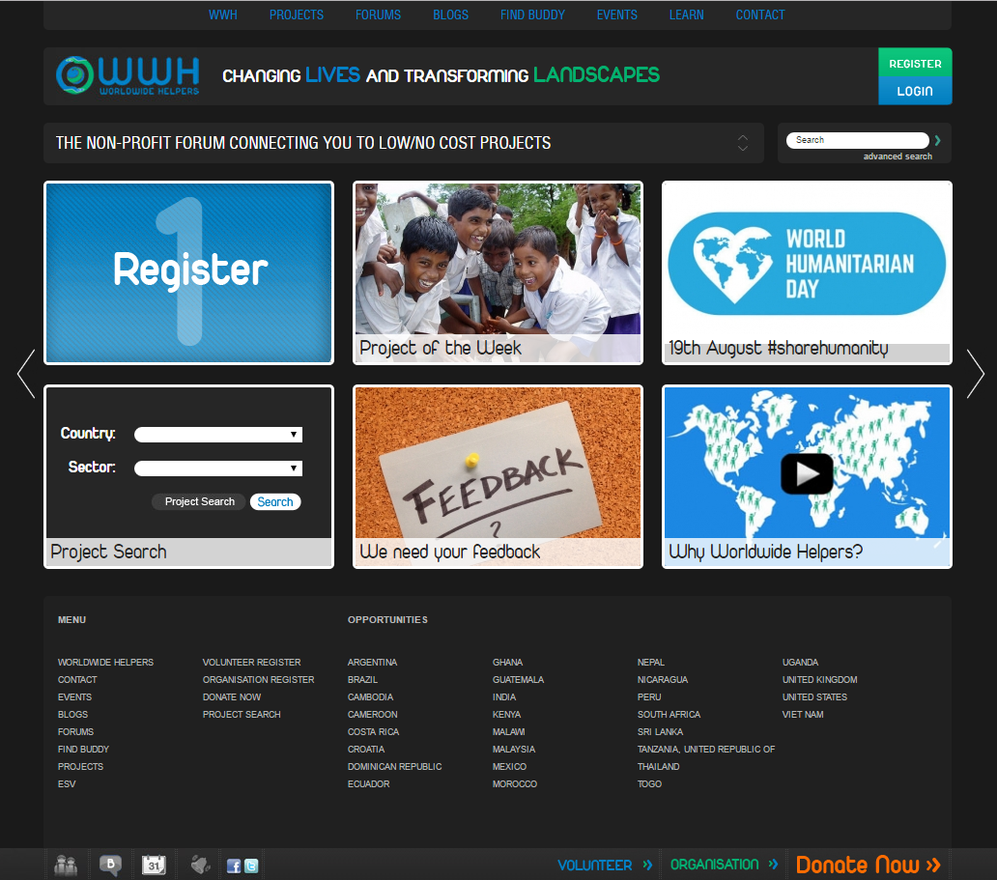
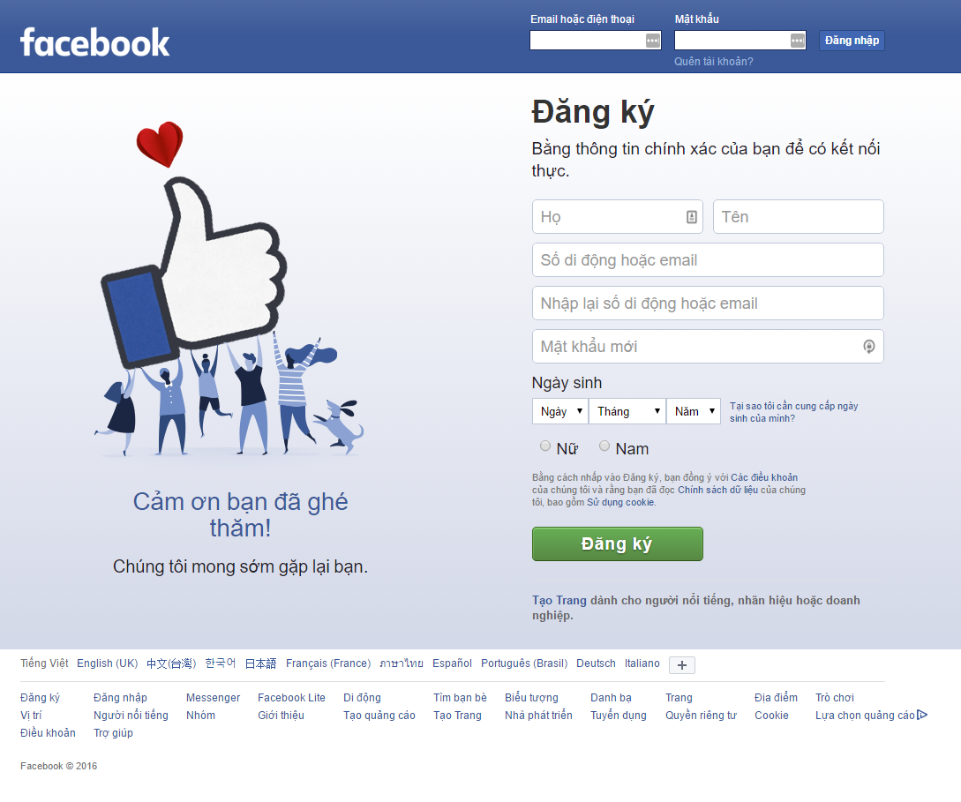
I . INTRODUCTION
1. Current Situation - 現在状況
Literature review
2. The Idea - アイデア
I. 導入
7

Slide 8

1. Current Situation - 現在状況
I . INTRODUCTION
2. The Idea - アイデア
3. Proposal - 提案
Nowadays, Volunteering has been expanding in many countries in the world
But the recent volunteering has revealed some limitations:
The communication of the events, coordinating the activities
Publicize and expand/extent the platforms
Mentioning/commending individuals who have contributed/devoted for volunteering
Build a volunteer social network called by “iVolunteer” allow:
The volunteer and organization which joining in volunteer activities connect with other
Launching the volunteer project or joining other volunteer
I. 導入
8

Slide 9
PRESENTATION OUTLINE
II. PROJECT MANAGERMENT
I
Introduction
Project Management
II
導入
プロジェクト管理
III
Software Requirements Specification
Software Design Description
IV
ソフトウェア要求仕様
ソフトウェア設計説明書
V
Quality Control
Project Result
VI
品質管理
プロジェクト結果
VII
Demo
Q & A
VIII
デモ
質問と回答
Coming
Nguyễn Minh Đức
9

Slide 10
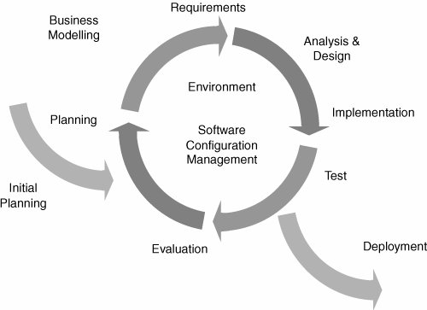
II. PROJECT MANAGERMENT
1. Software Process Model - ソフトウェアプロセスモデル
Iterative and Incremental
II. プロジェクト管理
10

Slide 11
II. PROJECT MANAGERMENT
2. Project Organization -プロジェクト組織
Bùi Đình
Chiến
Instructor
Nguyễn Minh
Đức
Project Manager
Nguyễn Thạc
Sơn
Phạm Văn
Trọng
Võ Tôn
Phúc
Technical Leader
Test Leader/ QA
Design Leader
Nguyễn Minh
Đức
Võ Tôn
Phúc
Nguyễn Văn
Tâm
Nguyễn Văn
Tâm
Developer
Developer
Developer
Designer
II. プロジェクト管理
11

Slide 12
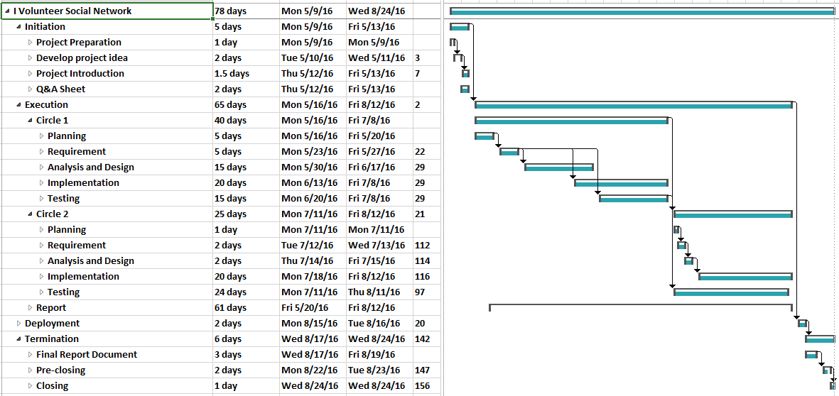
II. PROJECT MANAGERMENT
3. Project Schedule - プロジェクト計画
II. プロジェクト管理
12

Slide 13
II. PROJECT MANAGERMENT
4. Objectives & deliverables -目標と成果物
No | Stage | Committed Delivery Date | Description of Deliverable | Delivery Media
Initiation |  |  | Requirements agreed, Report reviewed
1 | Q&A Management Sheet | 16-05-2016 | Criteria: Documentation reviewed | Commit Github
Execution |  |  | Product developed & tested and released to supervisor, documentation reviewed.
1 | Submit report no.1 final | 20-05-2016 | Completed report no.1 | Commit Github
2 | Submit report no.2 final | 03-06-2016 | Completed report no.2 | Commit Github
3 | Submit report no.3 final | 17-06-2016 | Completed report no.3 | Commit Github
4 | Submit report no.4 final | 05-08-2016 | Completed report no.4 | Commit Github
5 | Submit report no.5 final | 12-08-2016 | Completed report no.5 | Commit Github
6 | Complete Coding and Unit Test | 12-08-2016 | Source code Acceptance criteria: Product unit tested | Commit Github
7 | Complete Testing | 12-08-2016 | Criteria: Documentation reviewed | Commit Github
Termination |  |  | Project post-mortem is conducted, Project assets archived and released to supervisor
1 | Submit report no.6 final | 18-08-2016 | Completed report no.6 | Commit Github
2 | Submit all Final Documents and Source codes | 24-08-2016 | Final Documents and Source Code | Copy to CD and commit
3 | Represent capstone project | 25-08-2016 | Criteria: Completed | Presentation
4 | Project Complete | 01-09-2016 | Criteria: Completed
II. プロジェクト管理
13

Slide 14
















II. PROJECT MANAGERMENT
5. Tools & Infrastructure - ツールと インフラストラクチャ
TOOLS
Tools for project management
Tools for developing
Microsoft Project
Trello
GitHub
Redmine
Visual Studio
Google Chrome
Robo mongo
Sublime Text
SQL Server
Tools for document
Tools for design
Microsoft PowerPoint
Microsoft Word
Microsoft Excel
Microsoft Visio
Astah
Photoshop
Illustrator
II. プロジェクト管理
14

Slide 15
II. PROJECT MANAGERMENT
6. Risks management -リスク管理
No | Risk | Category | Root Cause | Triggers | Avoidance plan | Contingency plan | Fallback plan
1 | Requirement change | Process | SRS does not meet user requirement | Customer change requirement or some of requirements can be developed | Carefully analyze user requirement, know exactly team potentials, review by PM or Supervisor | Team should have a meeting to analyze change and decide actions | Re-estimate and update project plan Update requirement
リスク管理 - Risks management
II. プロジェクト管理
15

Slide 16
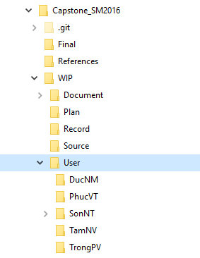
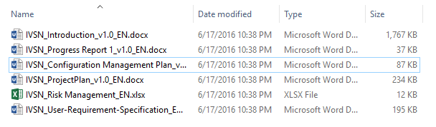
II. PROJECT MANAGERMENT
7. Configuration management - コンフィグレーション管理
Folder structure of project
Naming conventions
II. プロジェクト管理
16

Slide 17












II. PROJECT MANAGERMENT
8. Communication management - コミュニケーション管理
Time:
Communication
8 hours/day
5 days/week
Location
Meeting minutes
II. プロジェクト管理
17

Slide 18
PRESENTATION OUTLINE
III. SOFTWARE REQUIREMENTS SPECIFICATION
I
Introduction
Project Management
II
導入
プロジェクト管理
III
Software Requirements Specification
Software Design Description
IV
ソフトウェア要求仕様
ソフトウェア設計説明書
V
Quality Control
Project Result
VI
品質管理
プロジェクト結果
VII
Demo
Q & A
VIII
デモ
質問と回答
Coming
Nguyễn Văn Tâm
18

Slide 19
III. SOFTWARE REQUIREMENTS SPECIFICATION
1. Business Process - ビジネスプロセ
2. System Users - システムのユーザ
3. Functional Requirements - 機能要求
4. Non-Functional Requirements - 非機能要求
II. プロジェクト管理
19
III. ソフトウェア要求仕様

Slide 20
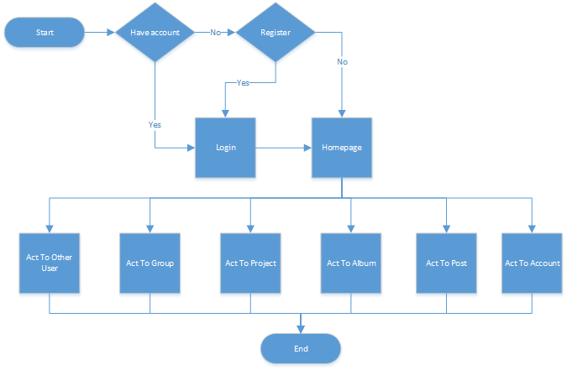
III. SOFTWARE REQUIREMENTS SPECIFICATION
1. Business Process - ビジネスプロセ
III. ソフトウェア要求仕様
20

Slide 21


III. SOFTWARE REQUIREMENTS SPECIFICATION
2. System Users - システムのユーザ
Guest
Registered User
Administrator
III. ソフトウェア要求仕様
21

Slide 22
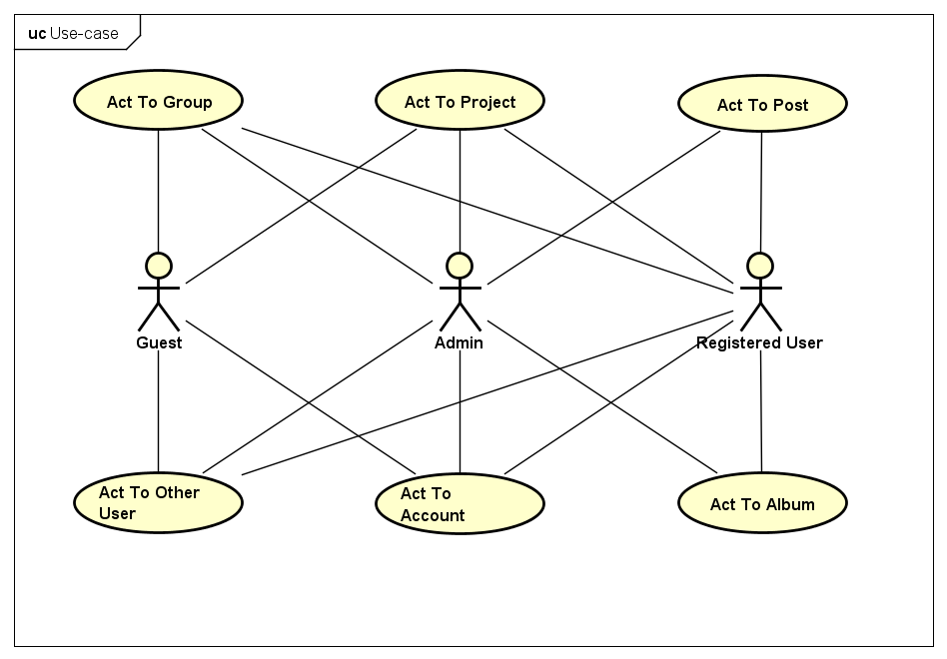
III. SOFTWARE REQUIREMENTS SPECIFICATION
3. Functional Requirements - 機能要求
ユースケース図 – User case diagram
III. ソフトウェア要求仕様
22

Slide 23
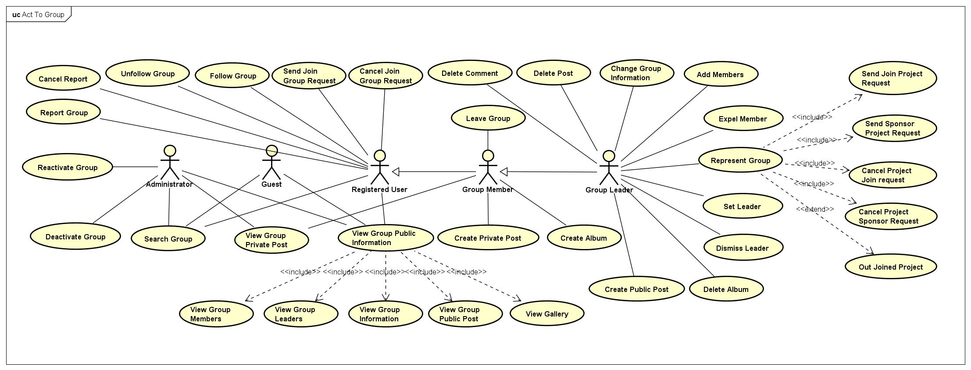
III. SOFTWARE REQUIREMENTS SPECIFICATION
3. Functional Requirements - 機能要求
ユースケース図 – User case diagram
III. ソフトウェア要求仕様
22

Slide 24
PRESENTATION OUTLINE
III. SOFTWARE REQUIREMENTS SPECIFICATION
4. Non-Functional Requirements - 非機能要求
User Interfaces
Language is Vietnamese
Scalability
Take advantages of MongoDB in scaling size of the Project
III. ソフトウェア要求仕様
23

Slide 25
PRESENTATION OUTLINE
IV. SOFTWARE DESIGN DESCRIPTION
I
Introduction
Project Management
II
導入
プロジェクト管理
III
Software Requirements Specification
Software Design Description
IV
ソフトウェア要求仕様
ソフトウェア設計説明書
V
Quality Control
Project Result
VI
品質管理
プロジェクト結果
VII
Demo
Q & A
VIII
デモ
質問と回答
Coming
Nguyễn Thạc Sơn
24

Slide 26
IV. SOFTWARE DESIGN DESCRIPTION
III. SOFTWARE REQUIREMENT SPECIFICATION
1. Technology & Reason - テクノロジーと理由
2. Architecture Representation - アーキテクチャ表現
3. Database Design - データベース設計
4. Detail Design - 詳細設計
IV. ソフトウェア設計説明書
25

Slide 27





IV. SOFTWARE DESIGN DESCRIPTION
III. SOFTWARE REQUIREMENT SPECIFICATION
1. Technology & Reason - テクノロジーと理由
Core Technology
ASP.NET MVC 5
MongoDB
SQL Server
Sub Technology
Bootstrap
SignalR
IV. ソフトウェア設計説明書
26

Slide 28
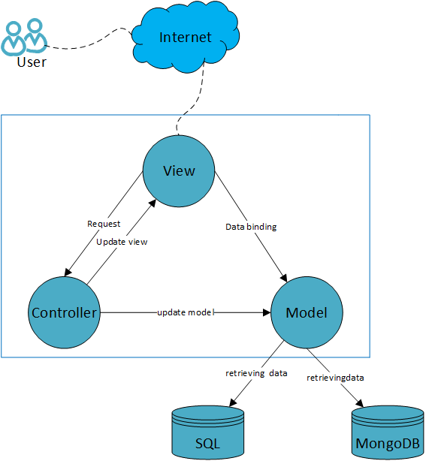
IV. SOFTWARE DESIGN DESCRIPTION
III. SOFTWARE REQUIREMENT SPECIFICATION
2. Architecture Representation - アーキテクチャ表現
iVolunteer system overall architecture
IV. ソフトウェア設計説明書
27

Slide 29
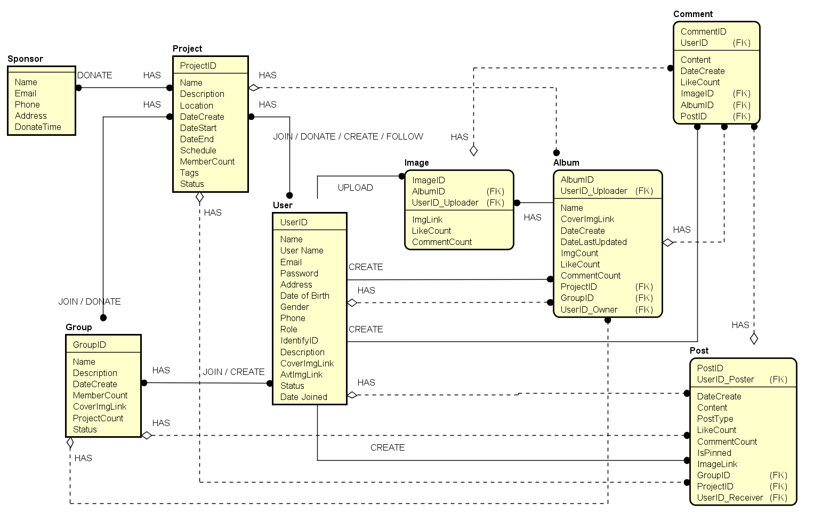
IV. SOFTWARE DESIGN DESCRIPTION
III. SOFTWARE REQUIREMENT SPECIFICATION
3. Database Design - データベース設計
エンティティ関係図
Entity Relationship Diagram
IV. ソフトウェア設計説明書
28

Slide 30
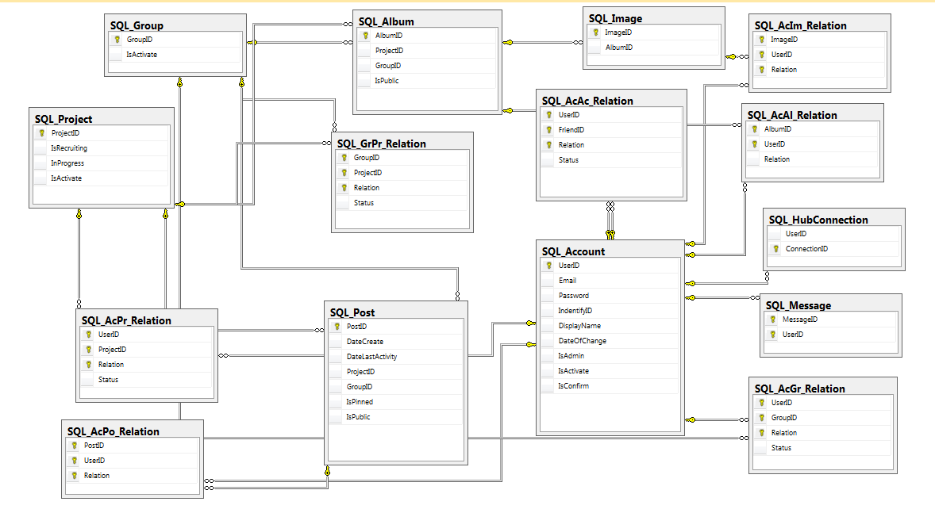
IV. SOFTWARE DESIGN DESCRIPTION
III. SOFTWARE REQUIREMENT SPECIFICATION
3. Database Design - データベース設計
SQLデータベース設計
SQL Database Design
IV. ソフトウェア設計説明書
29

Slide 31
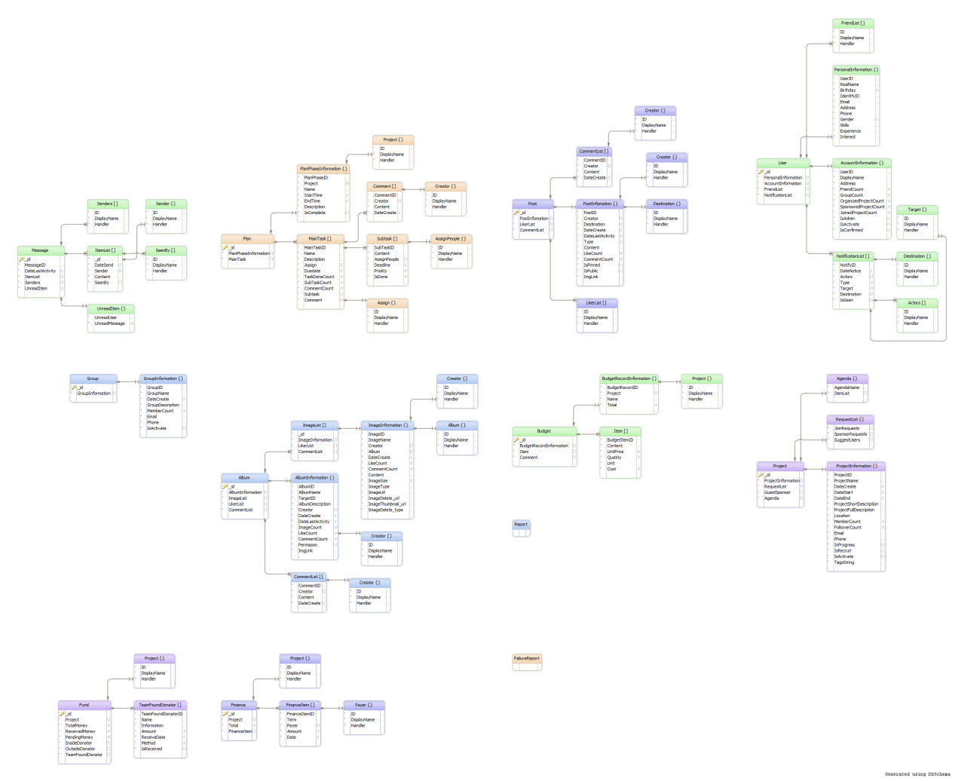
IV. SOFTWARE DESIGN DESCRIPTION
III. SOFTWARE REQUIREMENT SPECIFICATION
3. Database Design - データベース設計
MongoDBのデータベース設計
MongoDB Database Design
IV. ソフトウェア設計説明書
30

Slide 32
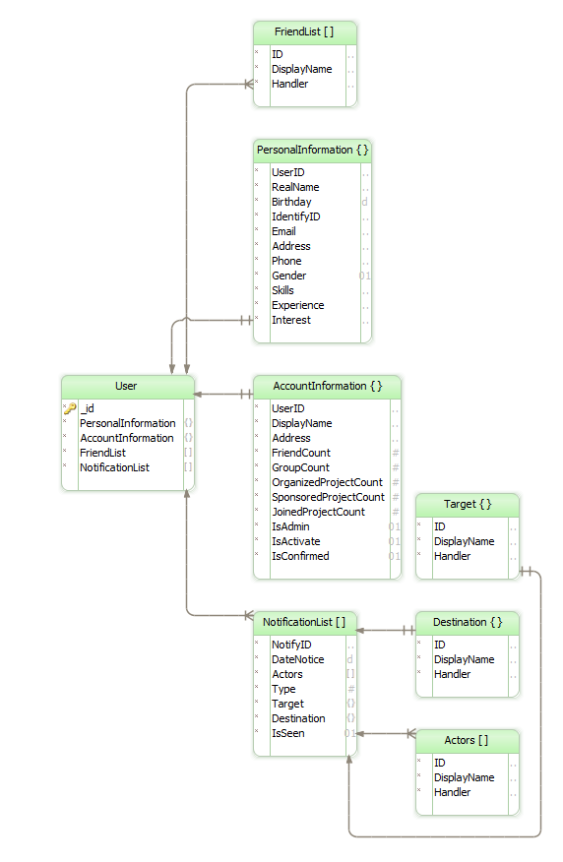
IV. SOFTWARE DESIGN DESCRIPTION
III. SOFTWARE REQUIREMENT SPECIFICATION
3. Database Design - データベース設計
ユーザーのMongoDBのデータベース設計
MongoDB User Design
MongoDBのデータベース設計
MongoDB Database Design
IV. ソフトウェア設計説明書
30

Slide 33
IV. SOFTWARE DESIGN DESCRIPTION
III. SOFTWARE REQUIREMENT SPECIFICATION
4. Detail Design - 詳細設計
Screen Flow - 画面の流れ
iVolunteerの画面の流れ
iVolunteer Screen Flow
IV. ソフトウェア設計説明書
31

Slide 34
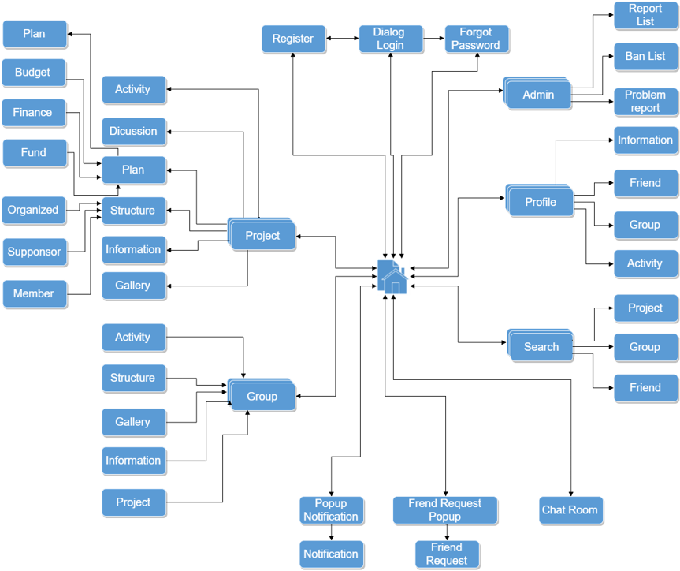
IV. SOFTWARE DESIGN DESCRIPTION
III. SOFTWARE REQUIREMENT SPECIFICATION
4. Detail Design - 詳細設計
Screen Flow - 画面の流れ
iVolunteerの画面の流れ
iVolunteer Screen Flow
画面の流れ
Screen Flow
IV. ソフトウェア設計説明書
31

Slide 35
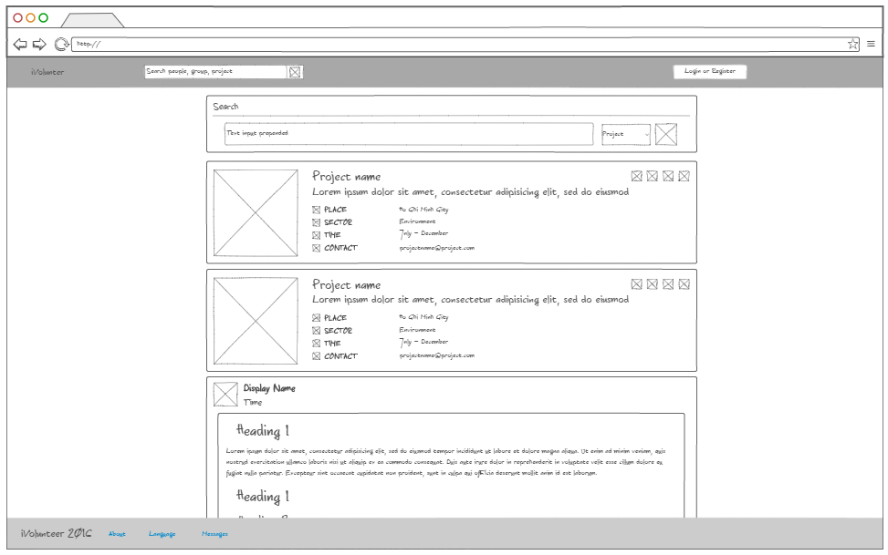
IV. SOFTWARE DESIGN DESCRIPTION
III. SOFTWARE REQUIREMENT SPECIFICATION
4. Detail Design - 詳細設計
Screen Design - 画面設計
ホームページの画面設計モックアップ – Homepage Screen Design Mockup
IV. ソフトウェア設計説明書
32

Slide 36
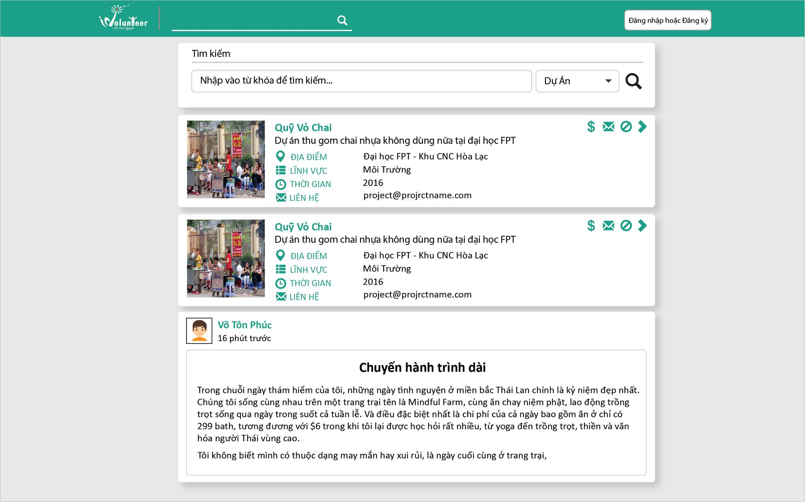
IV. SOFTWARE DESIGN DESCRIPTION
III. SOFTWARE REQUIREMENT SPECIFICATION
4. Detail Design - 詳細設計
Screen Design - 画面設計
ホームページの画面設計HTML – Homepage Screen Design by HTML
IV. ソフトウェア設計説明書
33

Slide 37
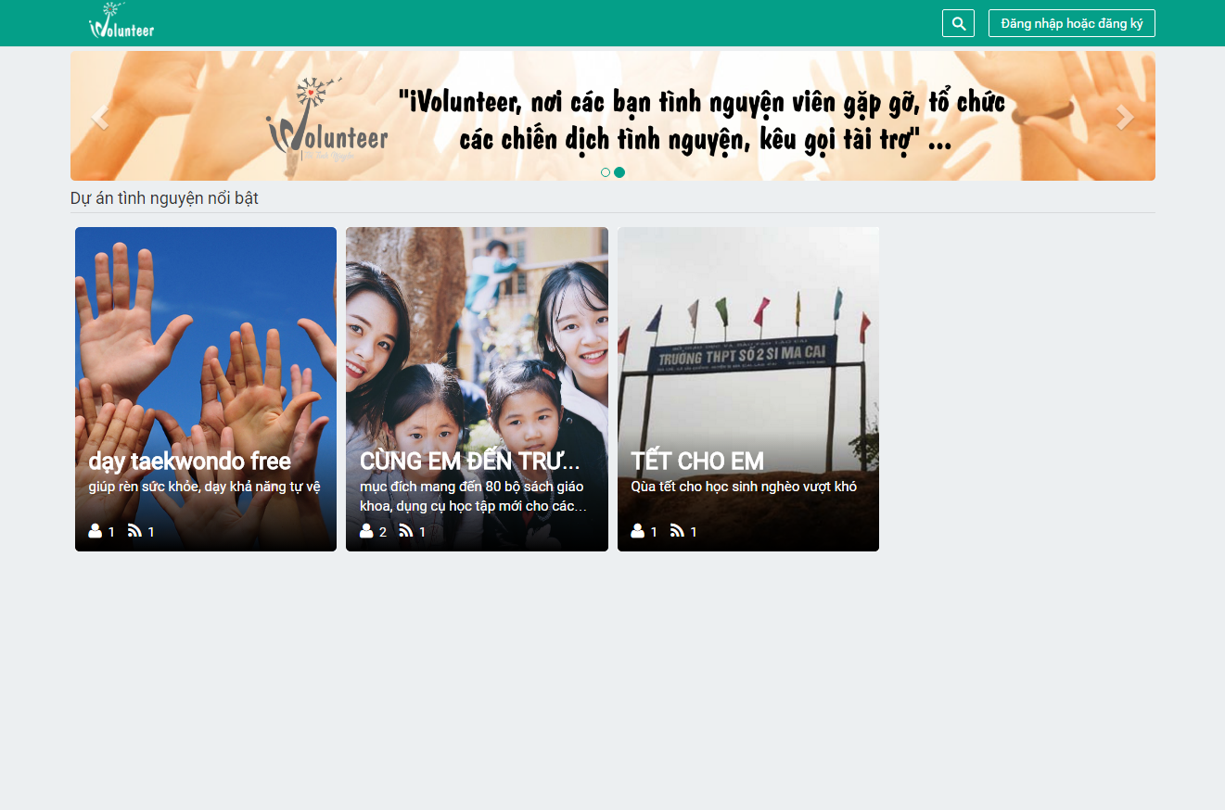
IV. SOFTWARE DESIGN DESCRIPTION
III. SOFTWARE REQUIREMENT SPECIFICATION
4. Detail Design - 詳細設計
Screen Design - 画面設計
ホームページの画面設計 – Homepage Screen Design
IV. ソフトウェア設計説明書
34

Slide 38
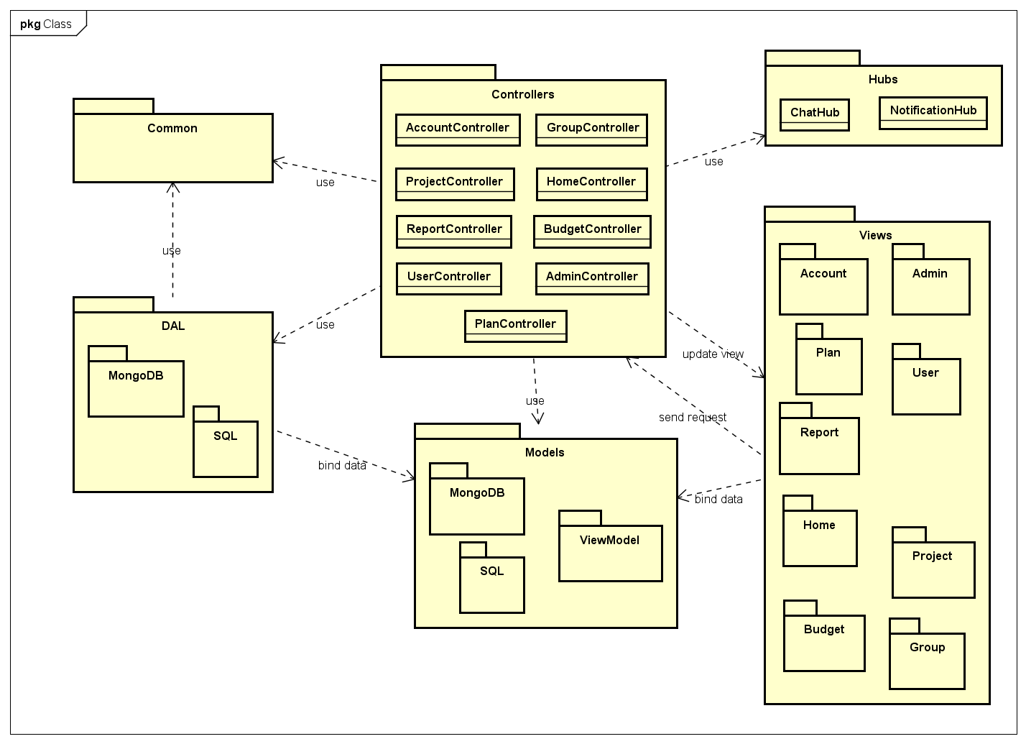
IV. SOFTWARE DESIGN DESCRIPTION
III. SOFTWARE REQUIREMENT SPECIFICATION
4. Detail Design - 詳細設計
Package View - パッケージ ビュー
パッケージ ビュー
Package View
IV. ソフトウェア設計説明書
35

Slide 39
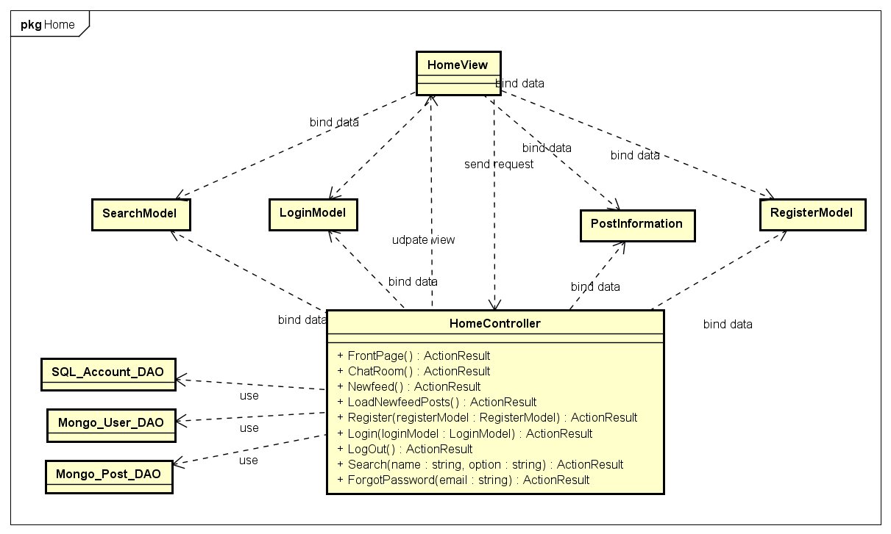
PRESENTATION OUTLINE
IV. SOFTWARE DESIGN DESCRIPTION
III. SOFTWARE REQUIREMENT SPECIFICATION
4. Detail Design - 詳細設計
Class Design - クラス設計
ホームコントローラのクラス設計 – HomeController Class Design
IV. ソフトウェア設計説明書
36

Slide 40
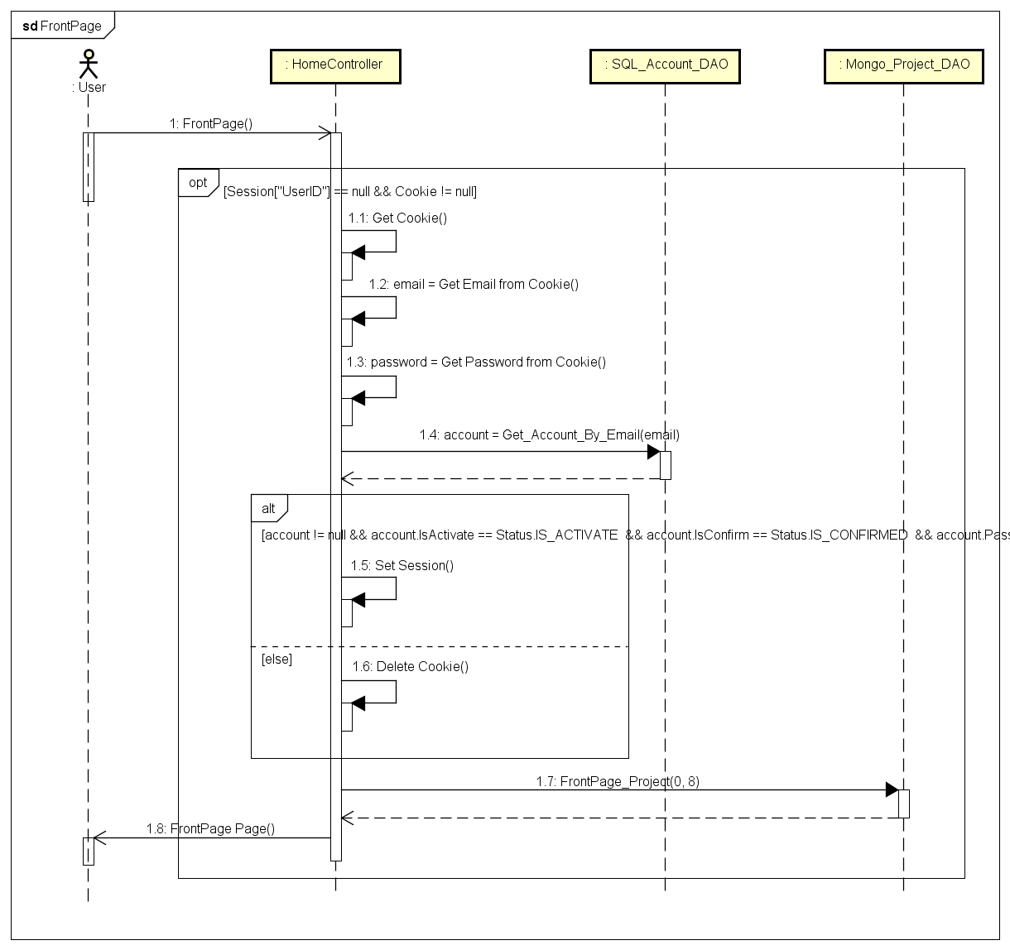
IV. SOFTWARE DESIGN DESCRIPTION
III. SOFTWARE REQUIREMENT SPECIFICATION
4. Detail Design - 詳細設計
Sequence Diagram - シーケンス図
ホームページのシーケンス図 – Homepage Sequence Diagram
IV. ソフトウェア設計説明書
37

Slide 41
IV. SOFTWARE DESIGN DESCRIPTION
III. SOFTWARE REQUIREMENT SPECIFICATION
4. Detail Design - 詳細設計
Sequence Diagram - シーケンス図
ホームページのシーケンス図 – Homepage Sequence Diagram
IV. ソフトウェア設計説明書
37

Slide 42
PRESENTATION OUTLINE
V. QUALITY CONTROL
I
Introduction
Project Management
II
導入
プロジェクト管理
III
Software Requirements Specification
Software Design Description
IV
ソフトウェア要求仕様
ソフトウェア設計説明書
V
Quality Control
Project Result
VI
品質管理
プロジェクト結果
VII
Demo
Q & A
VIII
デモ
質問と回答
Coming
Phạm Văn Trọng
38

Slide 43
V. QUALITY CONTROL
1. Review
レビュー
2. Testing
テスティング
1.1. Project Plan - プロジェクト計画
2.1. Test Process - テストプロセス
1.2. SRS - 要求仕様
2.2. Test Report - テストレポート
1.3. Design - 設計
1.3. Code - コーディング
1.4. Test Document - テスト
V. 品質管理
39

Slide 44
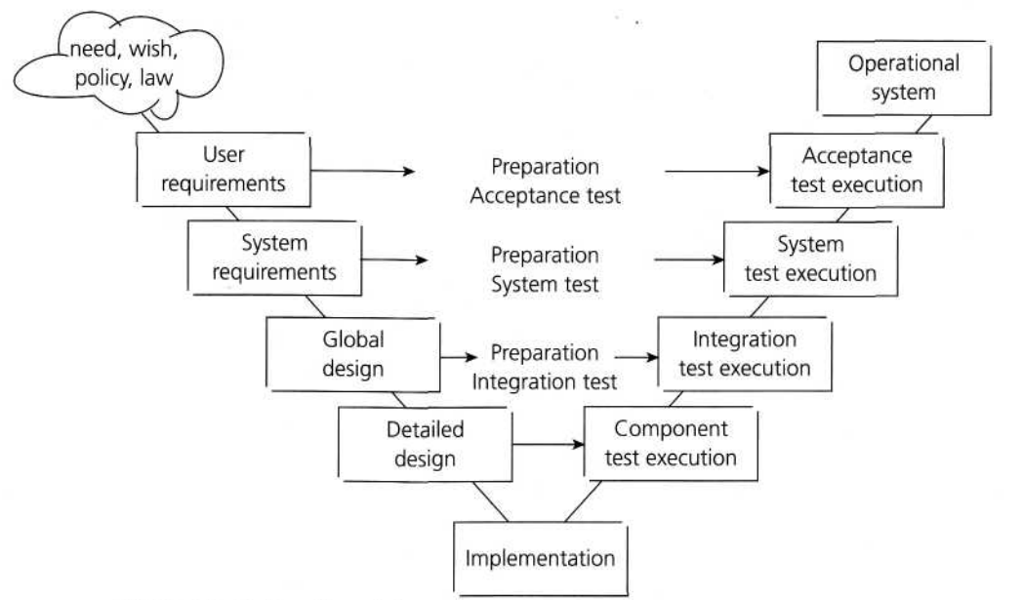
V. QUALITY CONTROL
1. Review - レビュー
V-model process
V. 品質管理
40

Slide 45



V. QUALITY CONTROL
1. Review - レビュー
自己評価
Self-review
ピアレビュー
Peer review
グループのレビュー
Group review
V. 品質管理
41

Slide 46
V. QUALITY CONTROL
2. Testing - テスティング
Create Test Plan
Create Test Viewpoint
Base on Project Plan, Project Schedule , SRS to create test plan:
Features to be tested
Testing Criteria
Environment
Schedules
Responsibilities
Risks and contingencies
Testing criteria:
Statement coverage: 100%
Branch coverage: 100%
Path coverage: 100%
Test Approach:
Unit Test: Developer
Integration Test: Tester
System Test: Tester
Acceptance Test: Supervisor
Test Environment:
Web :Chrome 52
V. 品質管理
42

Slide 47
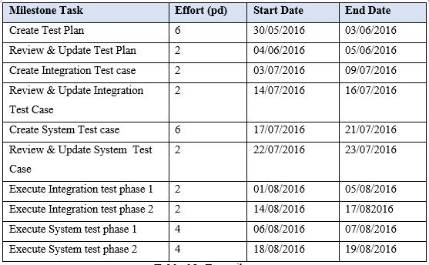
V. QUALITY CONTROL
2. Testing - テスティング
Create Test Plan
Create Test Case
Create Test Viewpoint
Acceptance criteria:
Statement coverage: 100%
Branch coverage: 100%
Path coverage: 100%
Test Approach:
Unit Test: Developer
Integration Test: Tester
System Test: Tester
Acceptance Test: Supervisor
Test Environment:
Web :Chrome 52
V. 品質管理
43

Slide 48
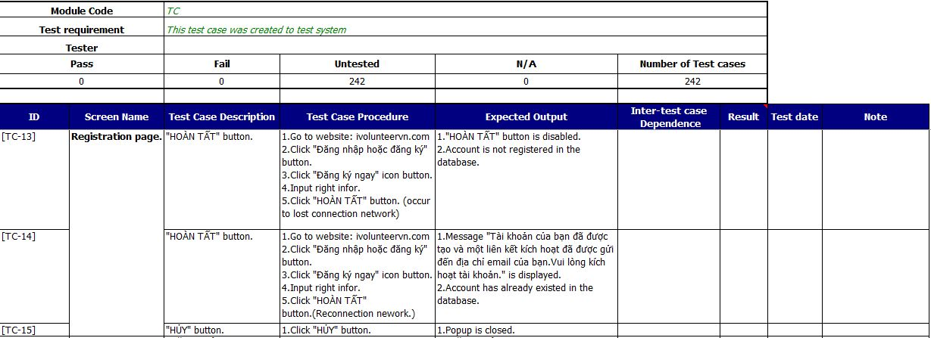
V. QUALITY CONTROL
2. Testing - テスティング
Create Test Plan
Create Test Case
Review Test Case
Base on SRS, create test case:
Unit test case
Integration test case
System test case
V. 品質管理
44

Slide 49
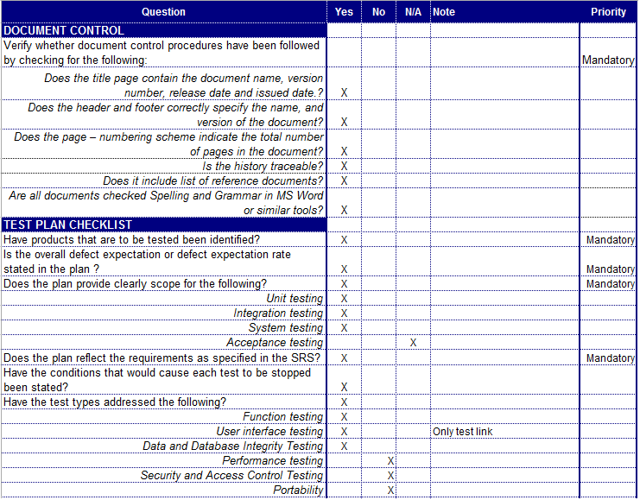
V. QUALITY CONTROL
2. Testing - テスティング
Create Test Plan
Create Test Case
Review Test Case
Developer self-review:
Unit test case
Tester self-review and peer-review:
Integration test case
System test case
Test case review checklist -テストレビュー
V. 品質管理
45

Slide 50
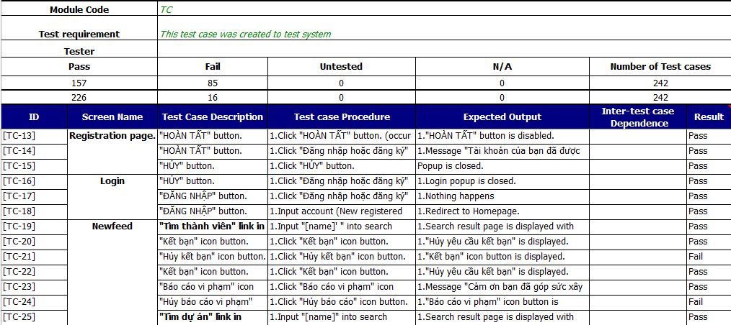
V. QUALITY CONTROL
2. Testing - テスティング
Create Test Plan
Create Test Case
Review Test Case
Execute Test
Tester execute test case follow phase:
Unit testing
Integration testing
System testing
Execute test case -テストケースの実行
V. 品質管理
46

Slide 51
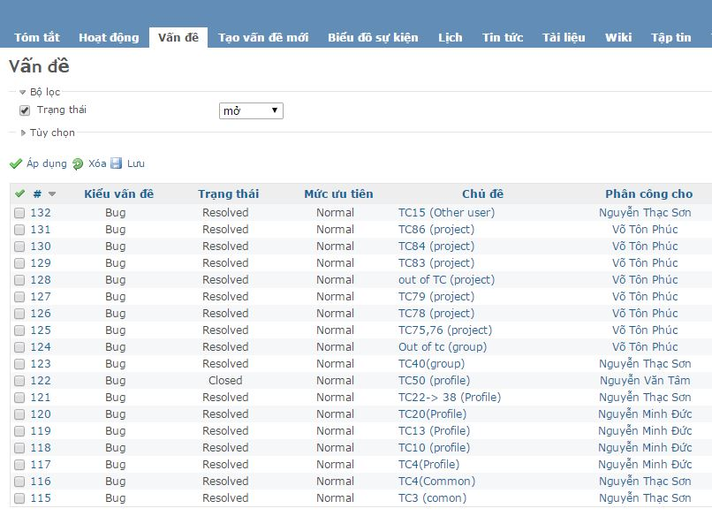
V. QUALITY CONTROL
2. Testing - テスティング
Create Test Case
Review Test Case
Execute Test
Log Bug
While executing test, tester detect, log bug and assign to appropriate developer.
Log bug at ivolunteer.m.redmine.org
V. 品質管理
47

Slide 52
V. QUALITY CONTROL
2. Testing - テスティング
Create Test Case
Review Test Case
Execute Test
Log Bug
Re-test
When Developer fixed bug, Tester re-test until bug was fixed successfully, then change defect of status to Closed.
V. 品質管理
48

Slide 53
V. QUALITY CONTROL
2. Testing - テスティング
Review Test Case
Execute Test
Log Bug
Re-test
Create Test Report
When Developer fixed bug, Tester re-test until bug was fixed successfully, then change defect of status to Closed.
Defects | Logged | %Closed | %Invalid | %Open
Critical | 1 | 100% | 0% | 0%
High | 2 | 100% | 0% | 0%
Medium | 61 | 100% | 0% | 0%
Low | 21 | 100% | 0% | 0%
Total | 85 | 100% | 0% | 0%
V. 品質管理
49

Slide 54
V. QUALITY CONTROL
2. Testing - テスティング
Review Test Case
Execute Test
Log Bug
Re-test
Create Test Report
Phase | Stage 1 |  | Stage 2 |  | Stage 3 |  | Final
 | Pass | Fail | Pass | Fail | Pass | Fail
Unit Test | 8 | 4 | 12 | 0 | 12 | 0 | 12
Integration Test | 548 | 122 | 599 | 71 | 670 | 0 | 670
System Test | 157 | 85 | 226 | 16 | 242 | 0 | 242
Total | 713 | 211 | 837 | 87 | 924 | 0 | 924
V. 品質管理
50

Slide 55
PRESENTATION OUTLINE
VI. PROJECT RESULT
I
Introduction
Project Management
II
導入
プロジェクト管理
III
Software Requirements Specification
Software Design Description
IV
ソフトウェア要求仕様
ソフトウェア設計説明書
V
Quality Control
Project Result
VI
品質管理
プロジェクト結果
VII
Demo
Q & A
VIII
デモ
質問と回答
Coming
Nguyễn Minh Đức
51

Slide 56
PRESENTATION OUTLINE
VI. PROJECT RESULT
1. Result - 結果
Main objective | Provide a websites help volunteer connect with other volunteer and help them manage, public their volunteer activities.
Purpose | Provide a iVolunteer online on website.
Source repository | https://github.com/LordofKnight93/Capstone_SM2016
 | Plan | Actual
Start date | 09/05/2016 | 09/05/2016
End date | 24/08/2016 | 24/08/2016
Release versions | 1.0 | 1.0
Duration | 78 | 78
Efforts (person day) | 390 | 390
Test cases | 1000 | 924
Defects | 135-195 | 207
Document pages | 200 | 220
Lines of code (Total) | 12000 | 15696
VI. プロジェクト結果
52

Slide 57
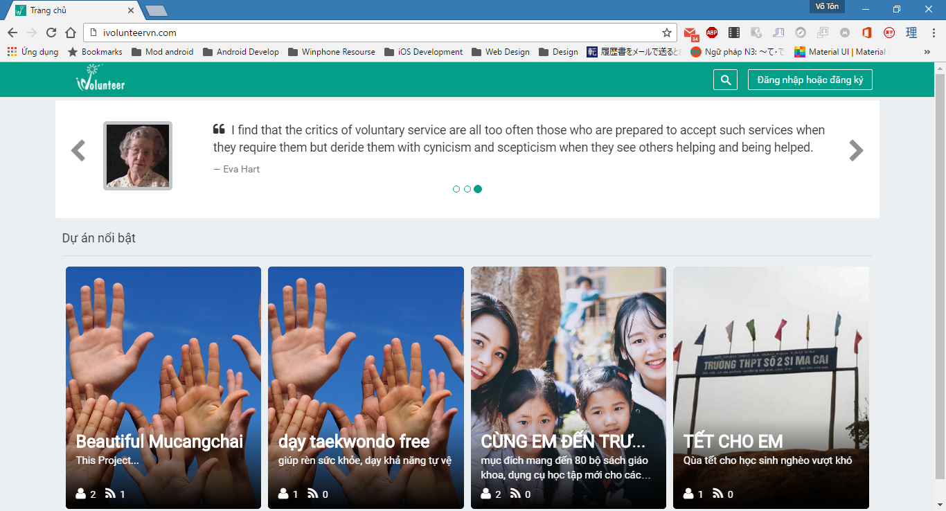
VI. PROJECT RESULT
1. Result - 結果
iVolunteerウエブサイト – iVolunteer Website
VI. プロジェクト結果
53

Slide 58
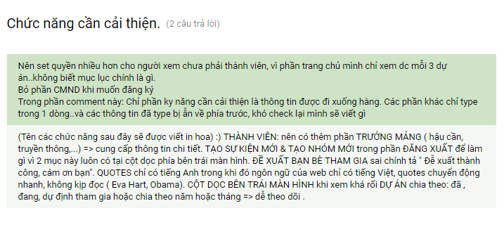
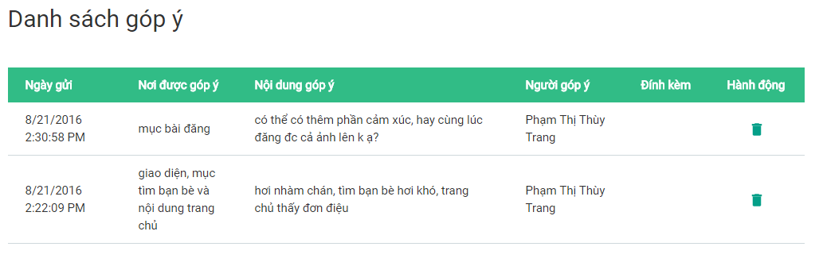
VI. PROJECT RESULT
1. Result - 結果
iVolunteerウエブサイトフィードバック – iVolunteer Website Feedback
VI. プロジェクト結果
54

Slide 59
PRESENTATION OUTLINE
VI. PROJECT RESULT
2. Limitation & Expectation - 制限と期待
Current Limitations
Expectation in Future
Website does not support Multilanguage
Support Multilanguage
Some screen cannot display well on Mobile or Tablet
Support view in Mobile and Tablet
Provide account registration by Gmail or Facebook account
Does not provide account registration by Gmail or Facebook account
Implement Full Text Searching
Does not implement Full Text Searching.
VI. プロジェクト結果
55

Slide 60
PRESENTATION OUTLINE
VI. PROJECT RESULT
3. Lessons Learnt - 学んだ教訓
Working in group and working individual.
Putting knowledge into practice.
Manage time and make the plan.
Be open to get the better opinions from other member.
Limit and resolve conflicts between members.
VI. プロジェクト結果
56

Slide 61
PRESENTATION OUTLINE
VII. DEMO
I
Introduction
Project Management
II
導入
プロジェクト管理
III
Software Requirements Specification
Software Design Description
IV
ソフトウェア要求仕様
ソフトウェア設計説明書
V
Quality Control
Project Result
VI
品質管理
プロジェクト結果
VII
Demo
Q & A
VIII
デモ
質問と回答
57

Slide 62
VII. DEMO
VI. PROJECT RESULT
Demo -デモ
VII. デモ
58

Slide 63
PRESENTATION OUTLINE
VIII. Q & A
I
Introduction
Project Management
II
導入
プロジェクト管理
III
Software Requirements Specification
Software Design Description
IV
ソフトウェア要求仕様
ソフトウェア設計説明書
V
Quality Control
Project Result
VI
品質管理
プロジェクト結果
VII
Demo
Q & A
VIII
デモ
質問と回答
59

Slide 64
VIII. Q & A
VI. PROJECT RESULT
Q & A -質問と回答
VII. 質問と回答
60

Slide 65
Q & A -質問と回答
THANKS FOR YOUR ATTENTION
VII. 質問と回答
71

